Slide 1



Cyber Maturity Model
How to Align to CIS for People Who Don't
Give a Shit About Controls
Michael Zbarsky • Josh Hohbein • Henry Timm • Roddy Bergeron
No alphabet soup. No compliance theater. Just the stuff that actually works.
Notes:
MICHAEL opens. 'If you came for CIS safeguard 4.7, wrong room.' ~3 min.

Slide 2

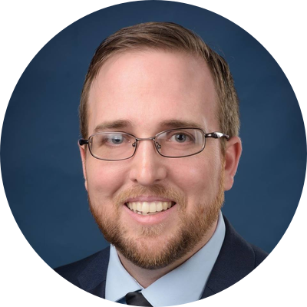
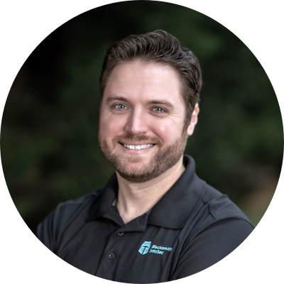
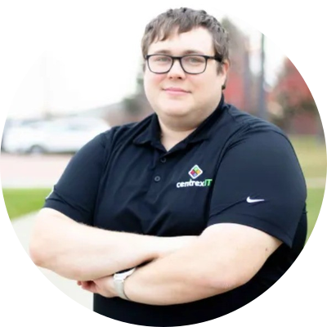
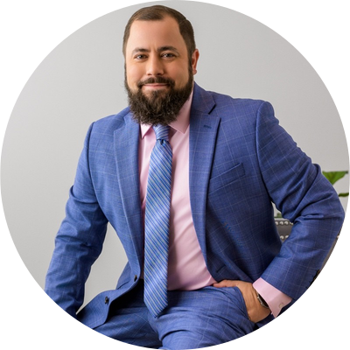
Who Are These Guys?
Michael Zbarsky
Josh Hohbein
Henry Timm
Roddy Bergeron
Cofounder
Director of Cybersecurity
Co-founder & CEO
Cyber Technical Fellow
20+ yrs making security make sense. Compliance nerd who defeated the spreadsheet final boss.
Former disc golf semi-pro. 4x ultra marathon finisher. Somehow also does cybersecurity.
A decade of helping MSPs not suck at security. Degenerately passionate.
Decades of auditing and MSP security. Has more certs than you have endpoints. Head is too big to fit on a normal sized frame.
Blacksmith InfoSec
centrexIT
Rocket Fuel Factory
Sherweb
Yes, we're qualified. No, we won't make this boring.
Notes:
30 sec each. Josh mentions disc golf career that didn't pan out. ~2 min.

Slide 3




The Actual Problem
You don't have a framework problem. You have a "getting shit done" problem.
Too many acronyms
NIST, CIS, ISO, SOC 2, CMMC... nobody can pick one so nobody picks any
Zero time
Your techs are drowning in tickets, not building security programs
Clients don't care
They want WiFi that works and to stop getting phished. That's it.
Controls → Spreadsheets
Frameworks turn into audit docs nobody reads instead of actions
Raise your hand if you've started a framework project and abandoned it. Yeah, we see you.
Notes:
HENRY. 'Show of hands: who tried a framework and gave up?' ~3 min.

Slide 4




Why Your Clients' Eyes Glaze Over
"Most clients won't give a shit about CIS/NIST controls. They want things to work." — Josh
Jargon overload
Wrong language
Missing the 'so what?'
You said 'CIS Control 1' and they heard 'blah blah blah'
They think in dollars and downtime, not safeguards and controls
You explained how MFA works. They needed to know why they should care.
If they understood the controls, they wouldn't need you.
If they understood the controls, they wouldn't need you.
Notes:
JOSH: 'I told a client CIS Control 1 and they said — is that a video game?' ~3 min.

Slide 5



Frameworks are maps.
Maturity is what you
actually do — repeatedly.
Nobody gets a trophy for owning a map.
Perfection? LOL. Not the goal.
Consistency is the goal.
Baseline first. Maturity second. Panic never.
Your framework isn't wrong. Your execution is.
Notes:
MICHAEL. Pause. Let it land. ~2 min.

Slide 6



The Holy Trinity of Not Getting Hacked
You cannot out-secure your organization's operational maturity. Full stop.
People
Process
Technology
Your humans are your biggest
asset AND your biggest risk.
If the CEO doesn't care,
nobody will.
Policies before tools. Always.
You can't create security policy
in a vacuum.
Documented > tribal knowledge.
Buy tools AFTER you know
what you need them for.
A $50K SIEM won't fix
your MFA problem.
Tools don't fix culture. Ask the rowing machine in the corner of my room with clothes on it.
Notes:
JOSH. '$50K SIEM and no MFA on their own RMM.' ~3 min.

Slide 7
The Maturity Ladder (You're Probably on Rung 1)
1
2
3
4
5
Initial
Developing
Defined
Managed
Optimized
"We have antivirus
somewhere, probably."
"We bought some tools
and wrote a policy once."
"We have real processes
and people follow them.
Mostly."
"We measure stuff,
have committees,
and can prove it."
"We continuously improve
and enjoy it." (Weirdos.)
Get to 3. Seriously. That's the whole talk.
You wouldn't build a $10,000 fence to protect a $2,000 llama, just ask Henry.
Notes:
RODDY. '$10K fence / $2K cow.' ~4 min.

Slide 8







Level 1: The "Bare Minimum" That Most People Skip
Patch Management
Designated Security Officer
MFA (yes, everywhere)
External Email Notice
EDR / MDR
3-2-1 Backup Strategy
Security Awareness Training
Vulnerability Visibility
If you're not doing these, you're not doing cybersecurity. You're doing IT with a prayer.
These are the freebies. You literally have no excuse.
Notes:
JOSH. 'The bar is on the floor.' Also what insurance requires. ~4 min.

Slide 9

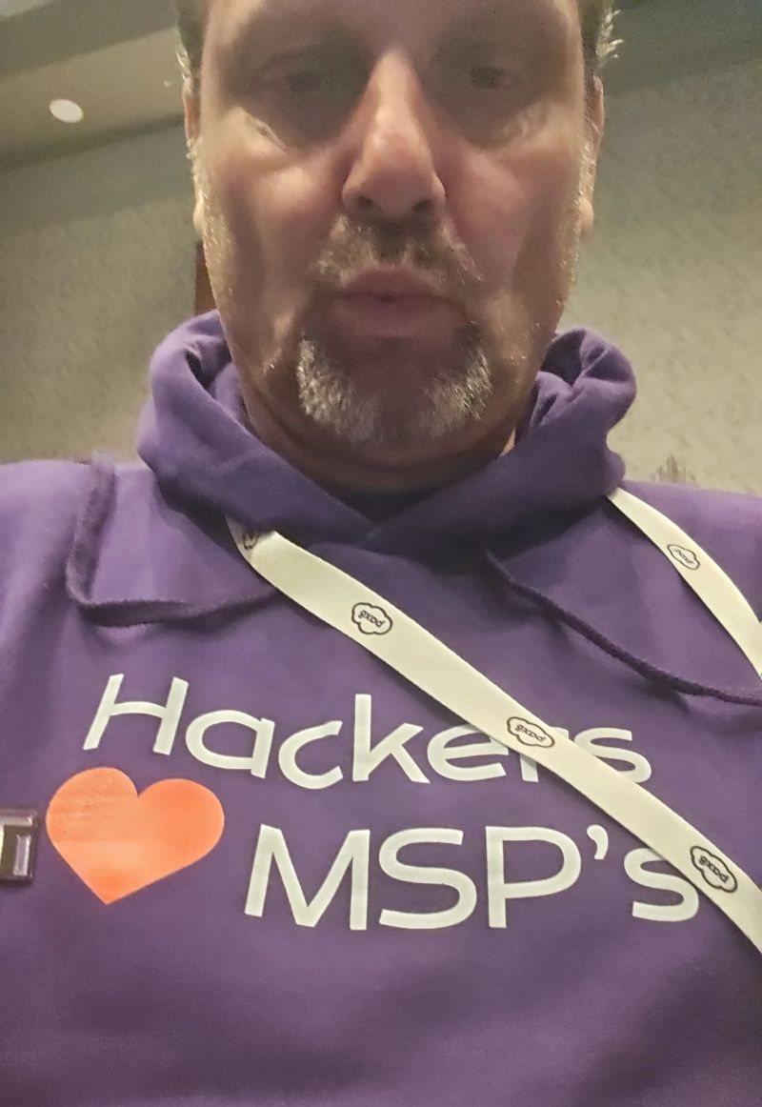
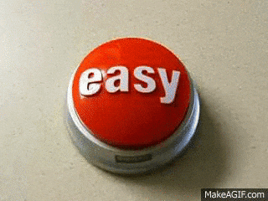


3 Reasons To Do This Stuff First
Insurance
Will Deny You
Hackers Love
Lazy Targets
They're
Basically Free
Most cyber insurance requires these. No controls = no claim = you're cooked.
Your car is locked, your neighbor's isn’t. Guess who gets broken into.
Low effort, low cost, low disruption. Appetizers while you build the main course.
You wouldn't build a $10,000 fence to protect a $2,000 llama, just ask Henry.
Notes:
JOSH. 'Your insurance won't pay without MFA. Now do you care?' ~3 min.

Slide 10
Levels 2–3: Now You're Actually Doing Things
Level 2: Getting Serious
Level 3: The Goal Line
Next Gen Firewall
Backup Test & Restore
DNS Filtering
Role-Specific Training
Tenant Hardening
Asset Management
MDM Deployment
Network Documentation
IR Personnel Identified
Authentication Controls
Disaster Recovery Plan
Data Protection Policies
Business Continuity Plan
Vulnerability Mgmt Process
Financial Controls
Incident Response Plan
Geo-Fencing
Level 3 is the goal for EVERY client. Period. No exceptions.
Level 1 = backups exist. Level 3 = you've actually tested them. Big difference.
Notes:
HENRY. 'Level 1: backups exist. Level 3: you've tested them.' ~4 min.

Slide 11
Levels 4–5: For the Overachievers
Level 4: Managed
Level 5: Boss Mode
Service Provider Management
Weekly Asset Inventory Review
Vuln Mgmt & Remediation
Advanced Log Collection
Penetration Testing
Advanced Service Provider Mgmt
Advanced Data Protection
Data Segmentation
SIEM Deployment
Administrative Air Gapping
SSO Deployment
Advanced Technical Control Auth
RBAC / Access Control Review
Advanced Asset Review
Pentesting at Level 4, not Level 1. If you aren't doing the basics, save the $15K and fix MFA first.
Nobody needs Level 5 unless a regulator is breathing down your neck.
Notes:
RODDY. 'If you don't have MFA, I can tell you the pentest result for free.' ~3 min.

Slide 12

The Stuff Nobody Warns You About
Staff Buy-In
No IT Surprises
Budget Reality
Security affects everyone
Gamify it — rewards > punishment
Security is NOT a punishment
If the CEO clicks the phish link,
you've got bigger problems
Communicate before rollout
Tell people what's changing
Document everything
Quickly fix what you break
People/Process controls first
Leverage the 'free wins'
Prioritize ROI, not cool factor
A tool won't save you
Kids respond better to playgrounds than threats. So do your users.
Notes:
HENRY. Kids respond to playgrounds better than threats. Same with users. ~3 min.

Slide 13

How to Screw This Up
(A field guide based on real MSPs we've watched face-plant)
Skipping alignment entirely
Jumping to ops before defining what 'good' even looks like.
Buying shiny tools first
You can't tool your way out of a process problem. Stop trying.
Confusing compliance with security
Compliance ≠ security. Security ≠ compliance. Tattoo this.
Deploying a SIEM on day one
You don't need logs if you don't have MFA. Walk before you run.
Calling a vuln scan an 'assessment'
A self-guided questionnaire isn't an assessment either. Stop it.
We've made all of these mistakes. That's how we know.
Notes:
JOSH. 'We've made all these mistakes. That's how we know.' ~5 min.

Slide 14




Framework Controls → Human Words
Access Control
Right people, right access, right now
Asset Management
Know what you have (HW, SW, Data, Cloud, People)
Incident Response
Know what happens on your worst day
Vulnerability Mgmt
Fix what hackers actually use
Recovery
Get back to work before the client notices
Successful communication isn’t you telling your client, it’s your client hearing you and understanding. (Just ask our kids)
We've made all of these mistakes. That's how we know.
Notes:
RODDY. 'If they can't repeat it, try smaller words.' ~3 min.

Slide 15

Maturity = Doing the Same Thing Twice
Same baseline across clients
Same expectations
Same reporting
Same remediation rhythm
Same explanations
Can't implement every control? Written policies bridge the gap.
Can't implement every control technically? Written policies bridge the gap. Alignment > perfection.
Your best tech doing hero work for one client isn't maturity. It's a bus factor of one.
Notes:
MICHAEL. 'Your newest tech following the same playbook — THAT'S maturity.' ~3 min.

Slide 16
How to Explain It Without Boring Everyone
5 sentences. Every conversation. Even if your client is half asleep.
1
What we found
2
Why it matters
3
Business impact (in dollars)
4
What good looks like
5
What we do next (and by when)
Works for QBRs, incident reports, and explaining things to your in-laws.
If you can explain it to a 10-year old, you can explain it to a client.
Notes:
HENRY. Real example: '14 machines no EDR. $200K ransomware risk. Deploy by Friday.' ~4 min.

Slide 17

The "What Do I Do Monday" Slide
Phase 1
Phase 2
Phase 3
Stop the
Bleeding
Make It
Repeatable
Prove It
Works
Define your baseline
Fix the obvious gaps
Inventory everything
Set minimum standards
Align your tool stack
Standardize processes
Assign ownership (names)
Document expectations
Build playbooks
Use framework as assessment
Track actual metrics
Prioritize by impact
Report in business terms
Utilize framework in QBRs
Always know what's next
Most MSPs try to jump to Phase 3. You can't measure what you haven't defined.
Notes:
RODDY. 'This is the slide you photograph.' ~3 min.

Slide 18
Let's Fight About It
Panel Discussion & Audience Q&A
→ What basics do MSPs skip the most?
→ Where do clients push back hardest?
→ What gets traction the fastest?
→ What does "good enough" look like?
No wrong answers. Except 'we should add more controls.'
Notes:
ALL PANELISTS. Let it get messy. ~15-20 min.

Slide 19

Stop Debating. Start Building.
The best framework is the one you actually use.
Michael Zbarsky • Josh Hohbein • Henry Timm • Roddy Bergeron
Come argue with us after. We're the ones at the bar.
Thanks for giving a shit.
Notes:
MICHAEL closes. 'Go to Level 3. Test your backups. Thanks for giving a shit.' ~2 min. TOTAL: ~55 min.

